Slide 1
Visual Analytics Final Project
Daniel Jakab, Ronan Hwang

Slide 2
Hypotheses
What is unique about the Green Line Extension’s consistency across different times of day
What is unique about trains going in different directions on the Green Line Extension relative to the rest of the green line
What is unique about the amount of time spent between stops at the Green Line Extension

Slide 3
Content
System that analyzes average headways by station, time of day (with different buckets)
Flask and pandas backend reads raw CSVs, filters by month/direction/scope, and aggregates headways via groupby
Used Claude AI assistance in building both the backend and frontend

Slide 4
Live Demo

Slide 5
Findings: Uniqueness GLX Consistency
At most hours of the day, the GLX has slightly lower headways than other stations
Difference is greatest n favor of GLX at 6:00-7:00 AM
The only time the GLX is less consistent than other trains is from 2:00 4:00 AM
Conclusion. GLX is generally more consistent than other trains especially at rush hour and with the exception of the early morning

Slide 6
Limitations with Data

Slide 7
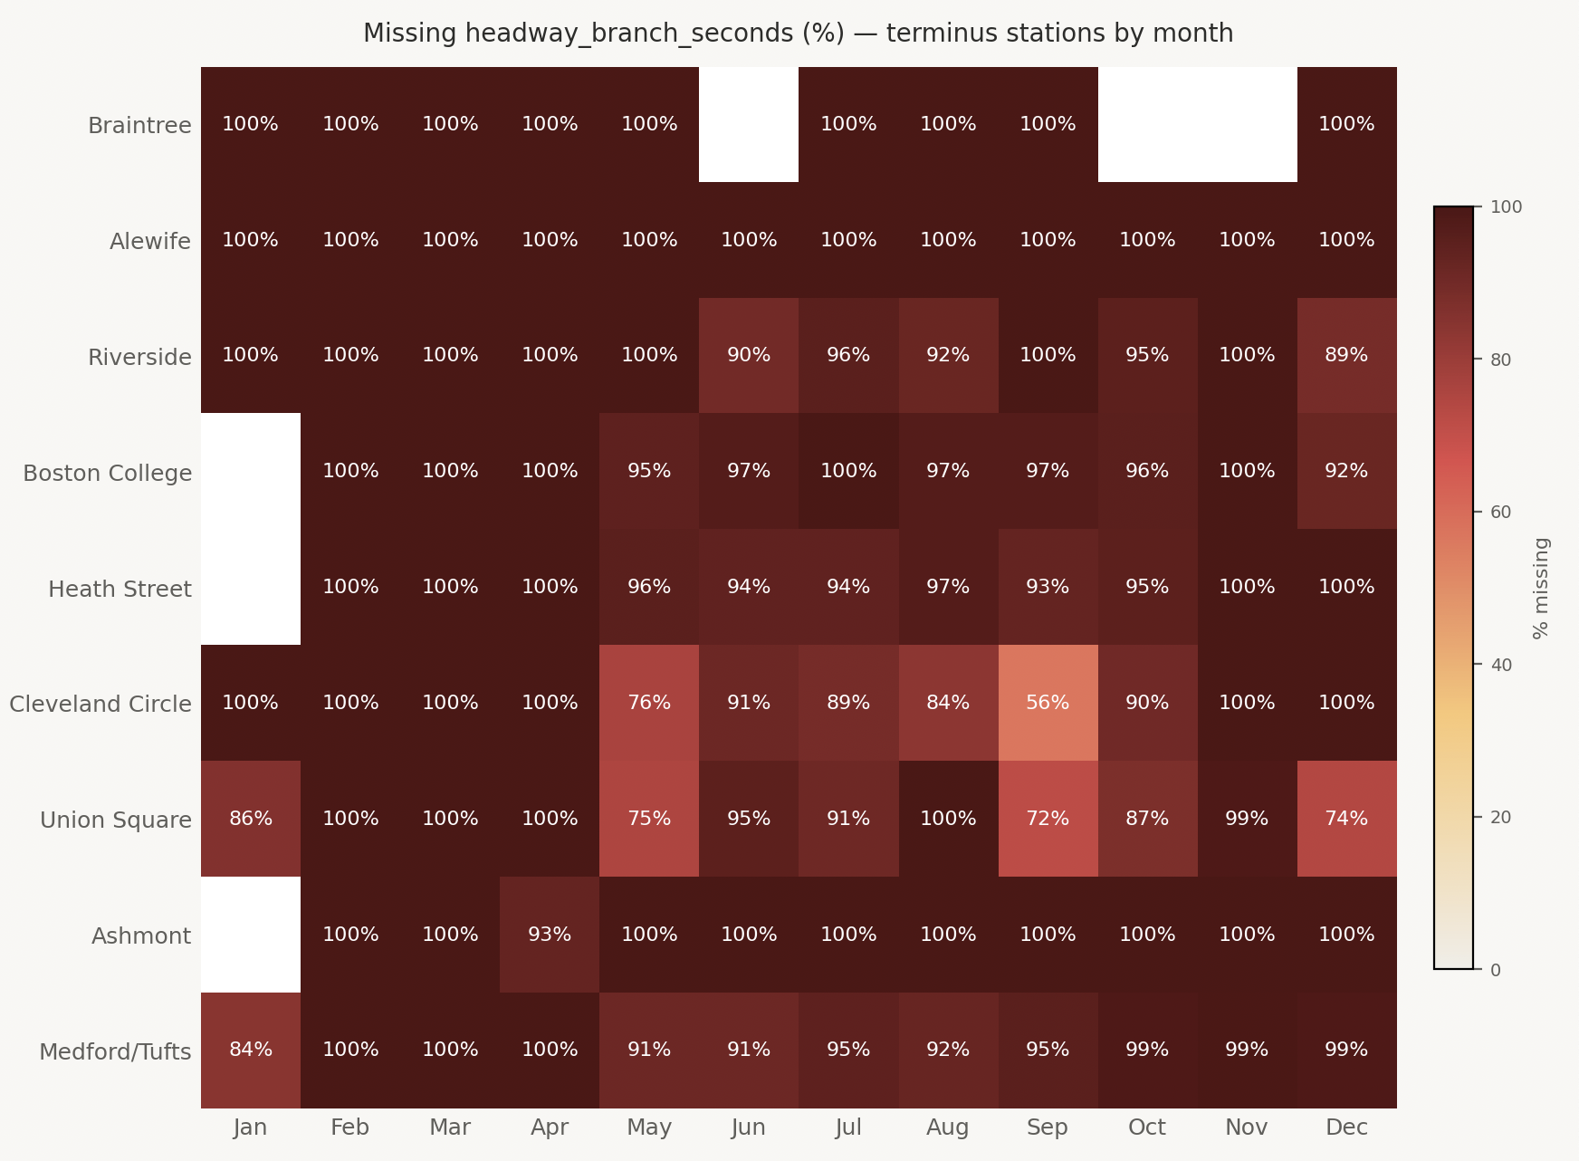
Limitations #1: Missing Data
31% of headway_branch_seconds missing
29% of branch_route_id missing
Branch‑level comparisons become unreliable

Slide 8
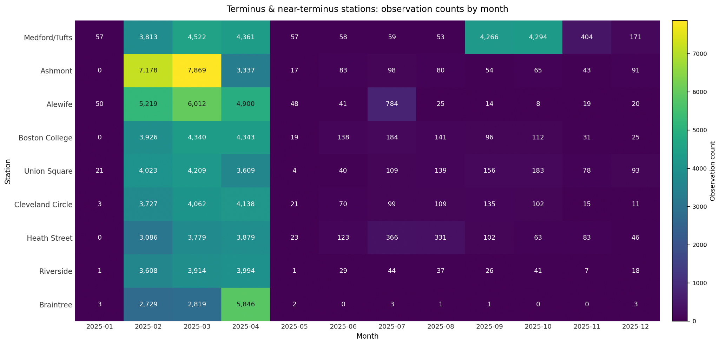
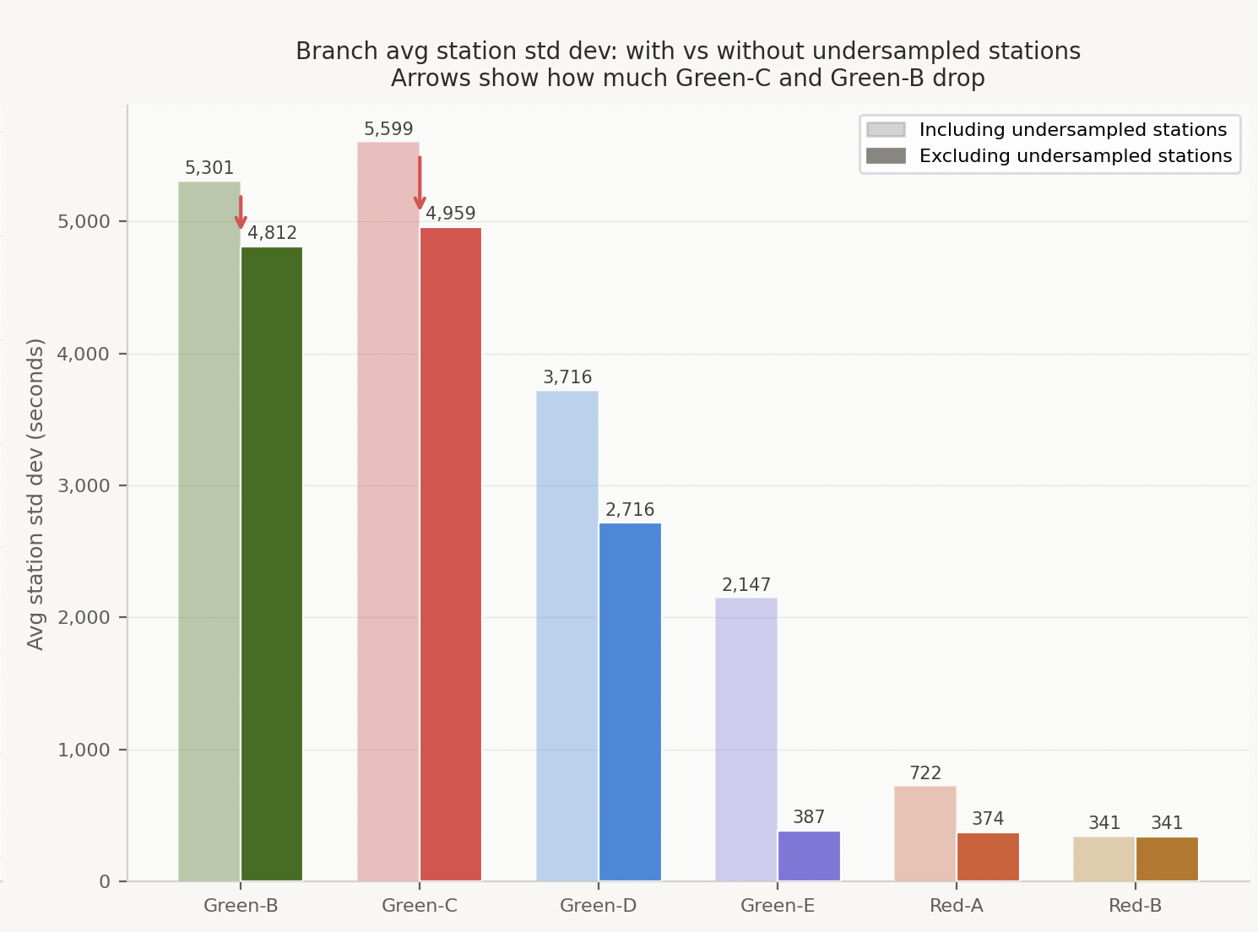
Limitations #2: Undersampling
Low observations at Terminus & near‑terminus stations
Sparse stations disproportionately raise branch‑level standard deviations
Affects variability

Slide 9
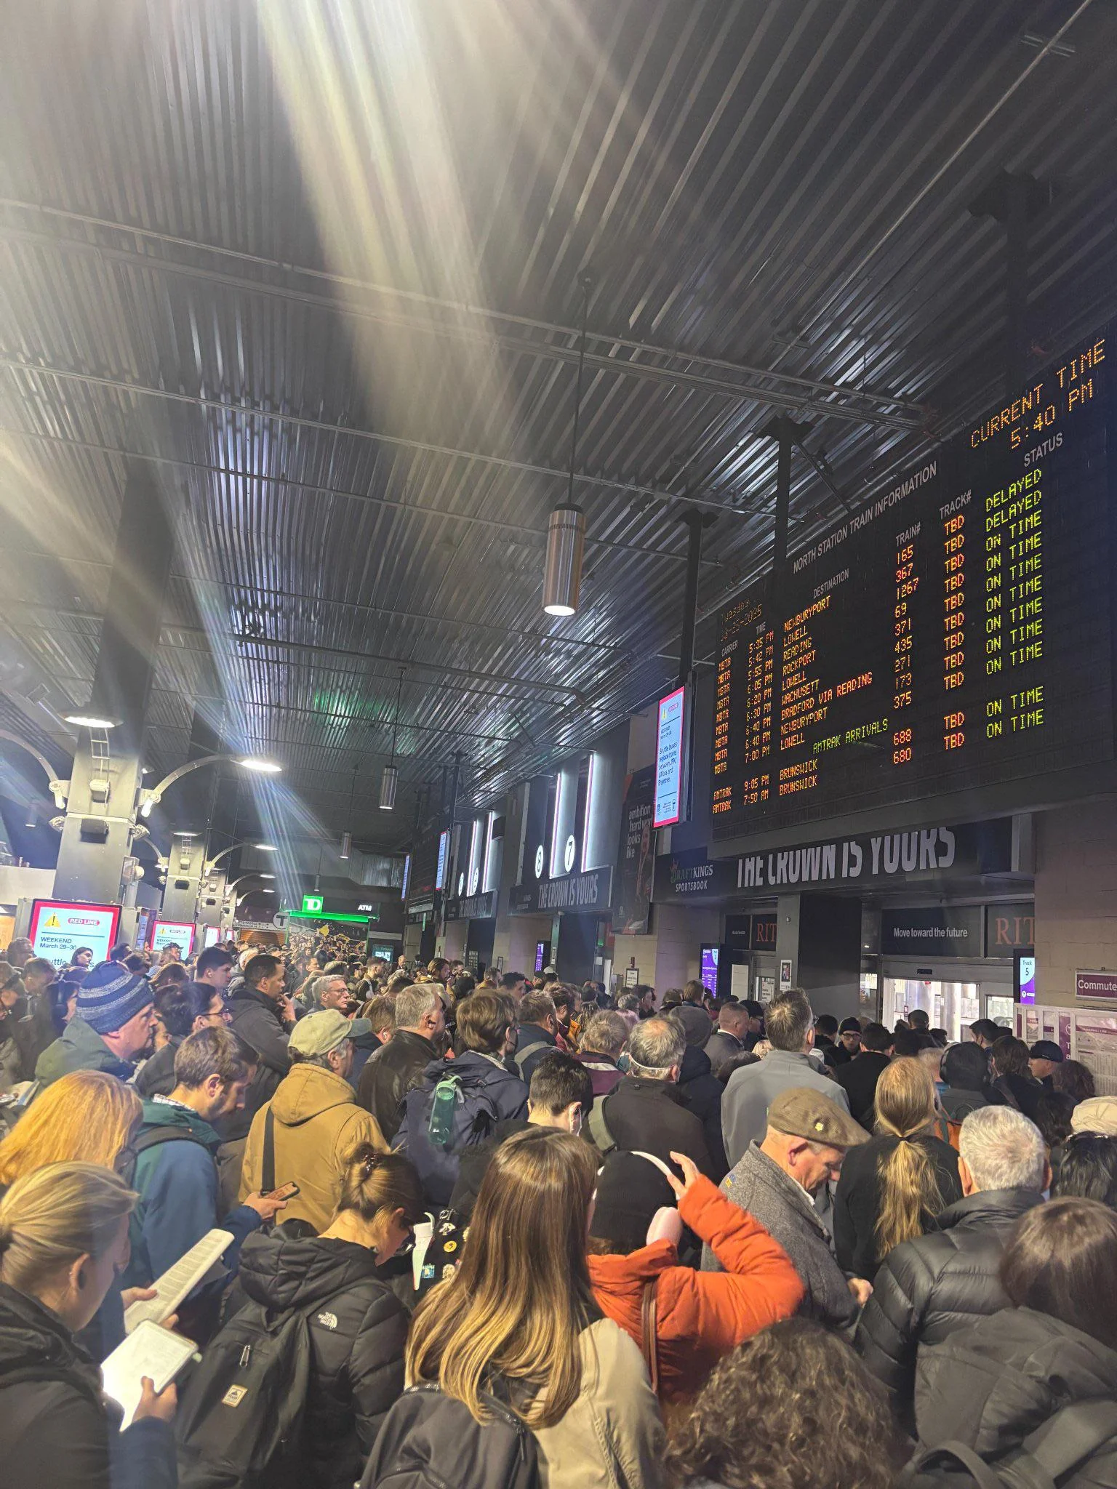
Limitations #3: Lack of contextual variables
No scheduled headways, delay indicators, or disruption flags
Dataset cannot distinguish operational issues from measurement issues

Slide 10
Conclusion
Most Important takeaways
The different ways the Green Line Extension to Tufts is unique
Experience of building a fullstack visual analytics system starting with hypotheses that we attempt to tackle via the system

